Slide 1


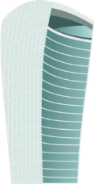
TIME TRAVEL
Scenes Roaming

Slide 2

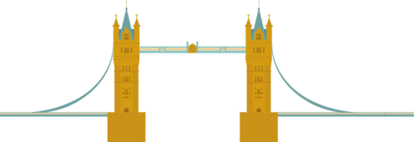


CONTENT
INTROCUTION
TEAM
BASIC & BONUS
TODO

Slide 3
INTORDUTION
Inspired by Stephen Hawking’s Wormhole time-travel theory
Learn more

Slide 4

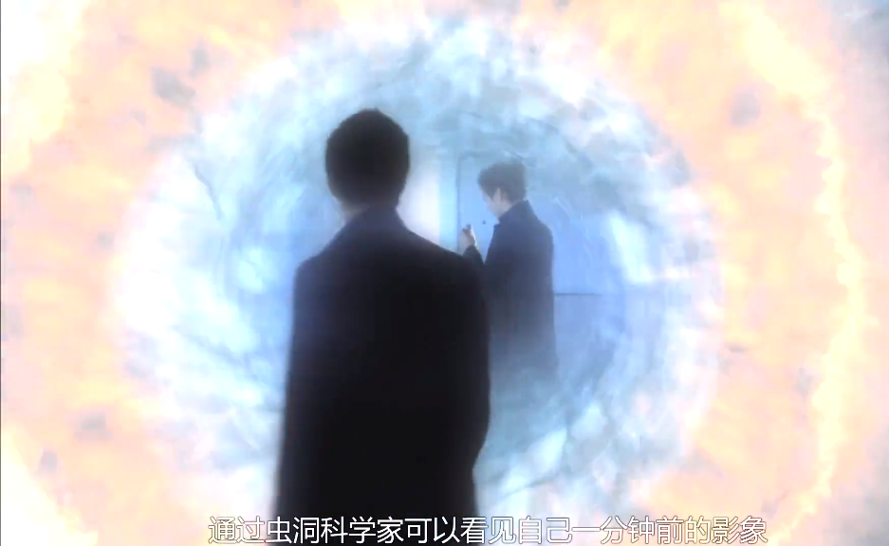
04
＊
INTORDUTION
Inspired by Stephen Hawking’s Wormhole time-travel theory
TIME TRAVEL
Wormhole conjecture: life is full of black holes, but they're just too small to see. One of hawking's documentaries suggests that through wormholes we can travel in time, back in time or into the future.

Slide 5
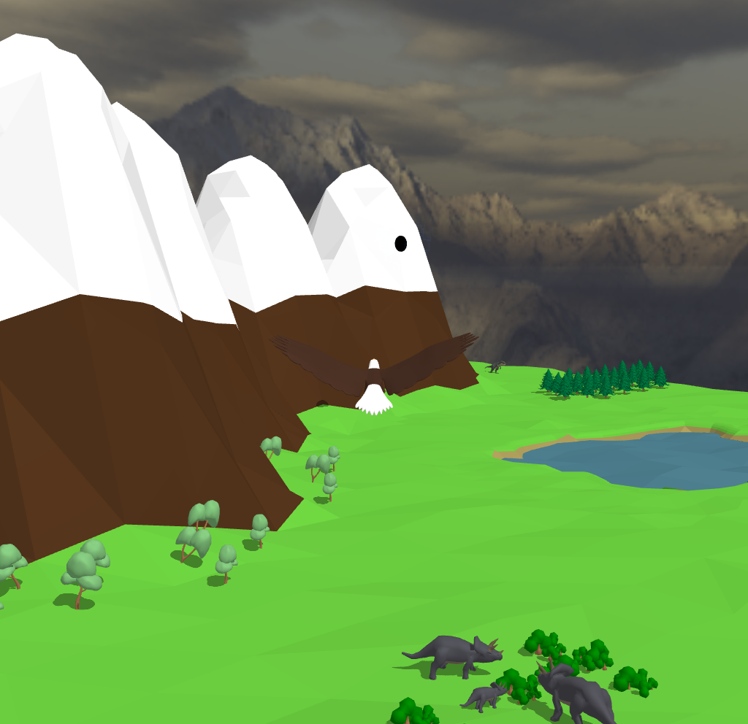
05
PAST
In the scene of PAST, we select dinosaurs as our major markers

Slide 6
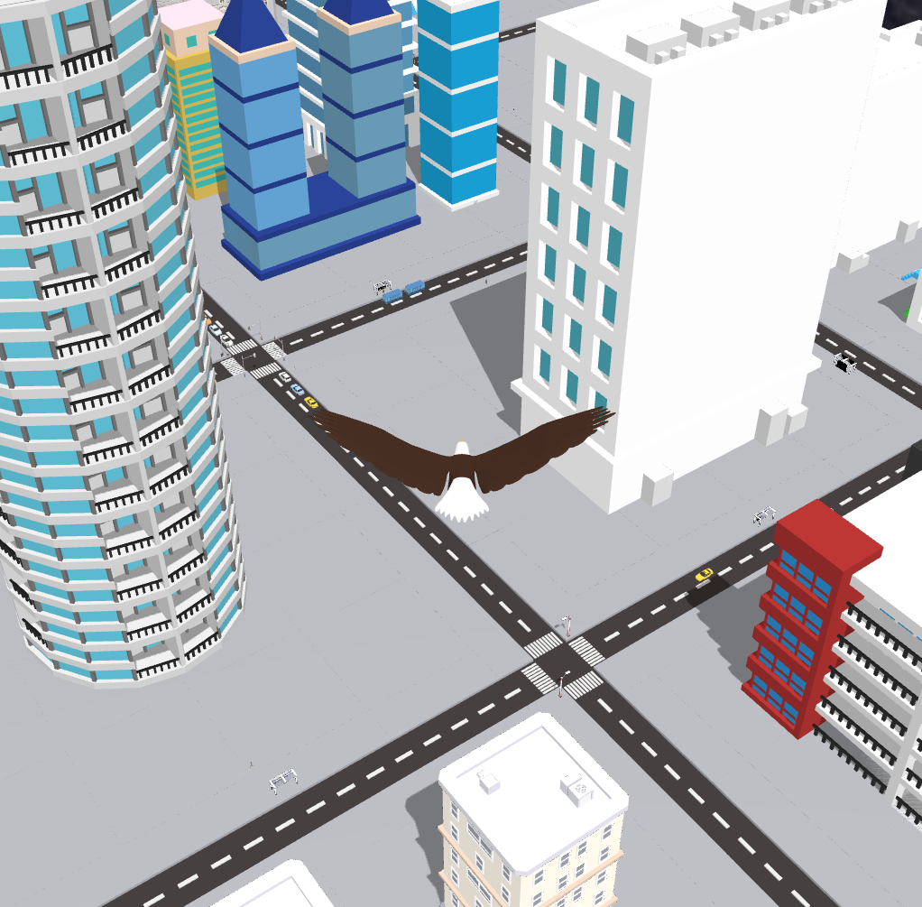
06
NOW
While in the scene of NOW, tall buildings and cars are our top choices.

Slide 7
TEAM
We come from the same dormitory and cooperate happily
Learn more

Slide 8
08
＊
TEAM
We come from the same dormitory and cooperate happily.
01
02
黄俊凯
黄嘉杰
负责场景建模
负责场景建模
03
04
黄俊杰
胡嘉鹏
负责光照、阴影、摄像机等
负责模型加载、场景切换、文字渲染等

Slide 9
BASIC & BONUS
Learn more

Slide 10
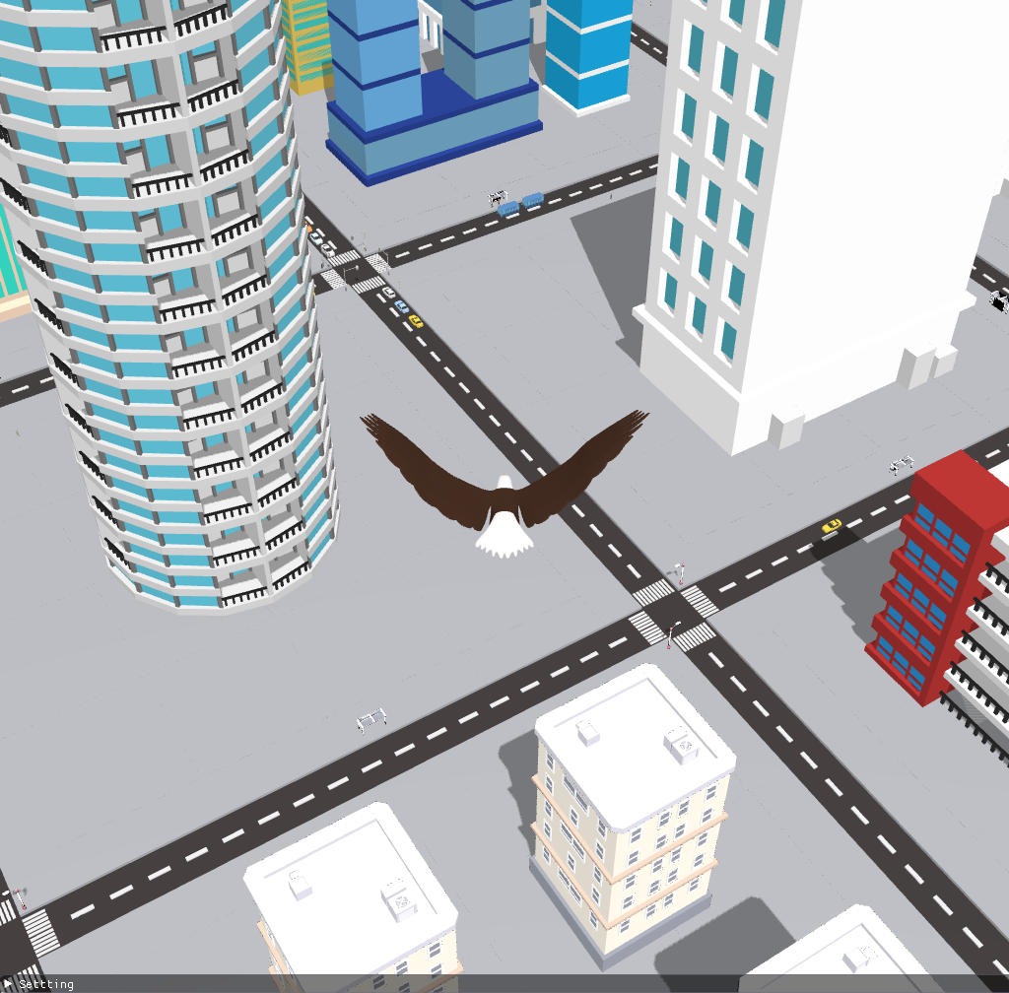
10
Camera Roaming
Place the eagle in front of the camera and let the eagle rotate with the camera to achieve a more realistic effect.

Slide 11
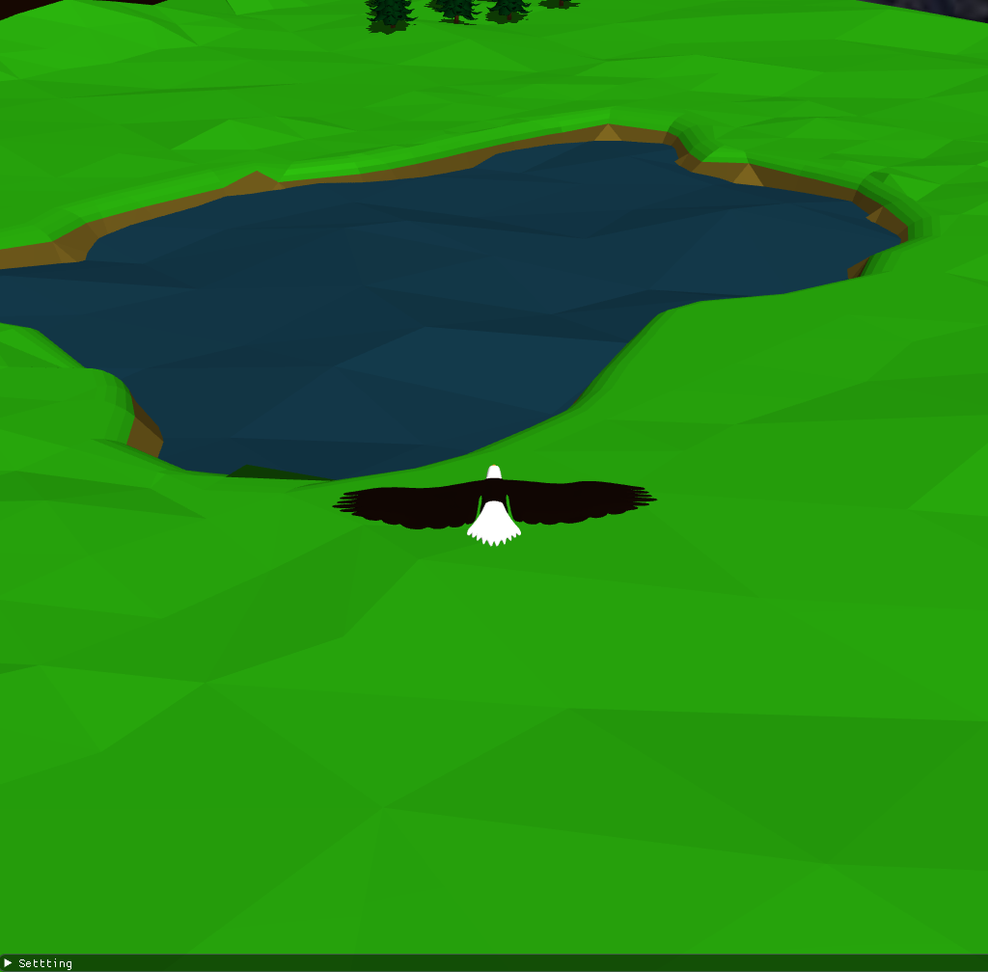
11
Simple Lighting
Use Phong lighting and shading, however, the color doesn't work as we expected. We will use Gamma correction to fix it later.

Slide 12
12
Shadow Mapping
Just follow up with Learn OpenGL.

Slide 13
13
＊
BASIC
Texture mapping
Model Import
We put it as part of the sky box
…

Slide 14
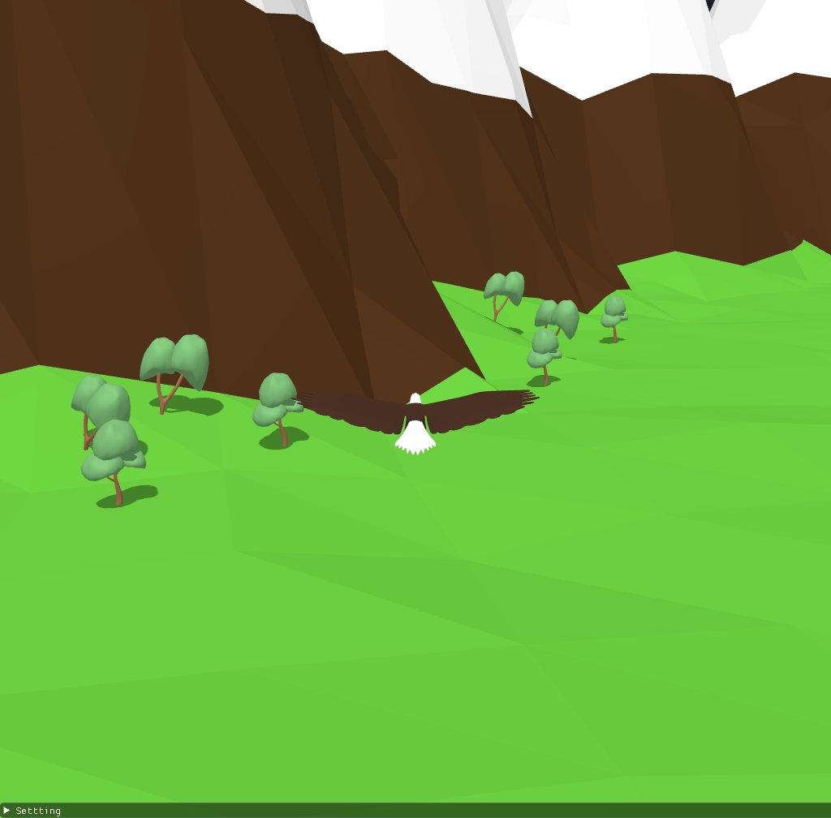
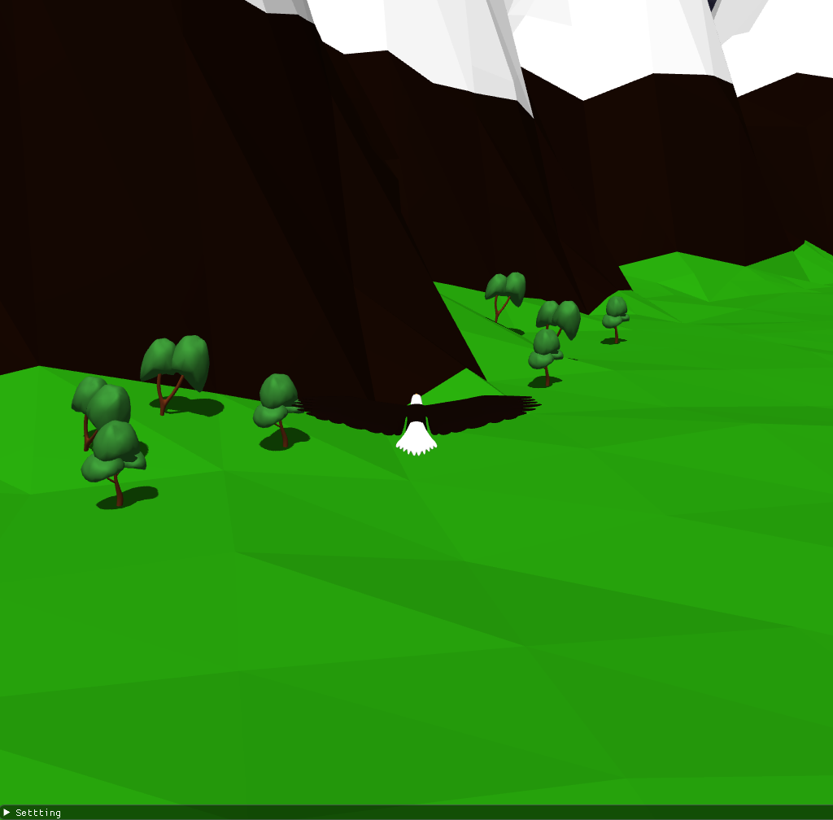
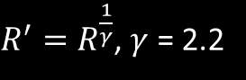
14
＊
BONUS
Gamma correction
Let us control light in linear space.
$R^{′}=R^{\frac{1}{γ}}$, $γ$ = 2.2

Slide 15
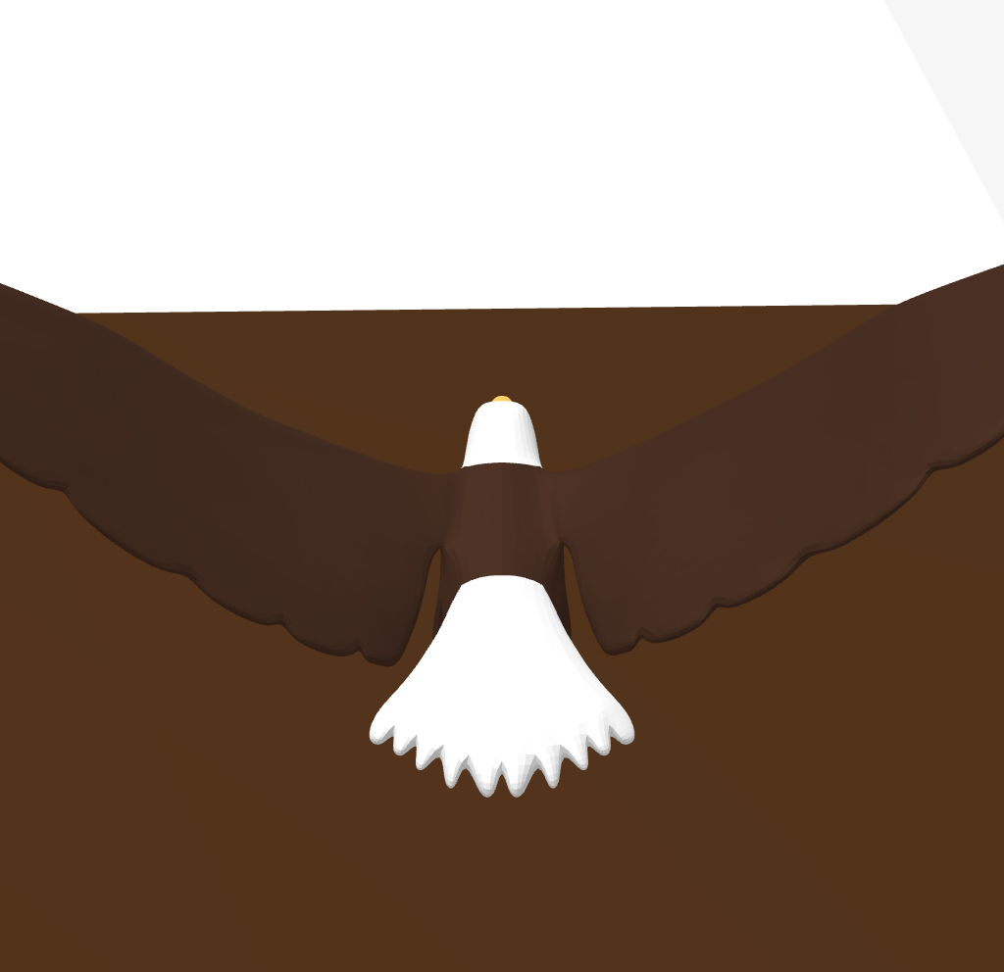
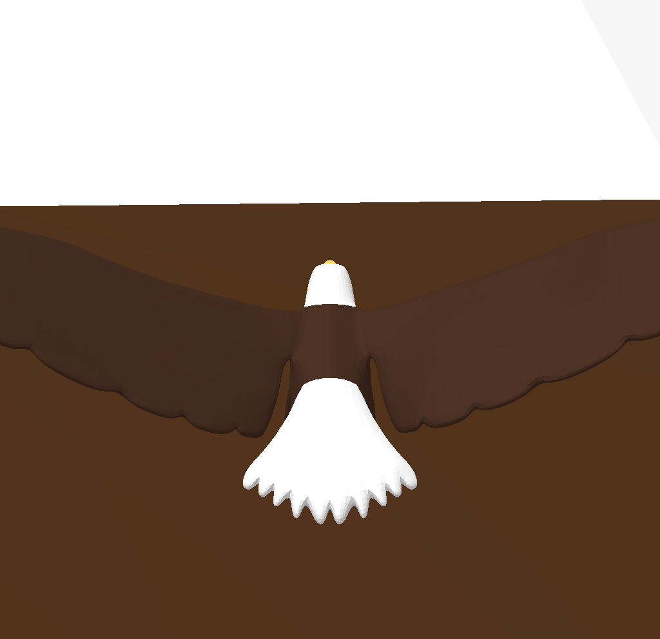
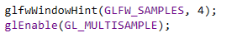
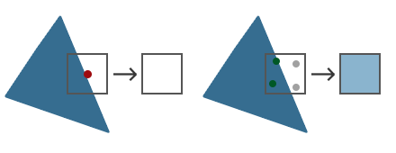
15
＊
BONUS
Anti-Aliasing
MSAA: use 4 subsample instead of 1.

Slide 16
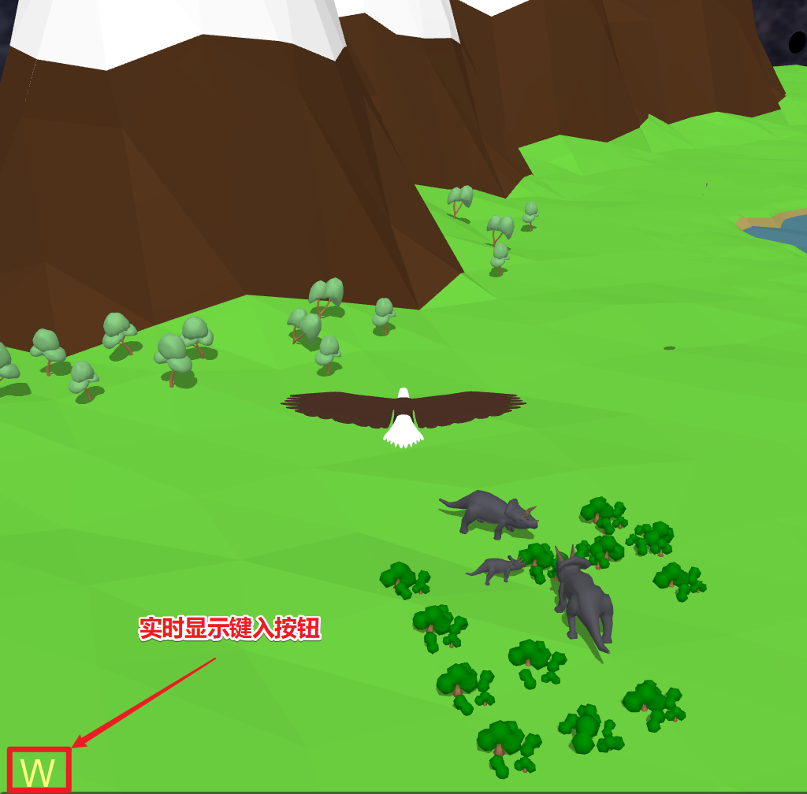
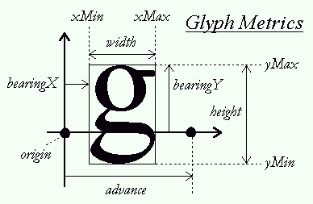
16
＊
BONUS
Display Text
FreeType Library

Slide 17
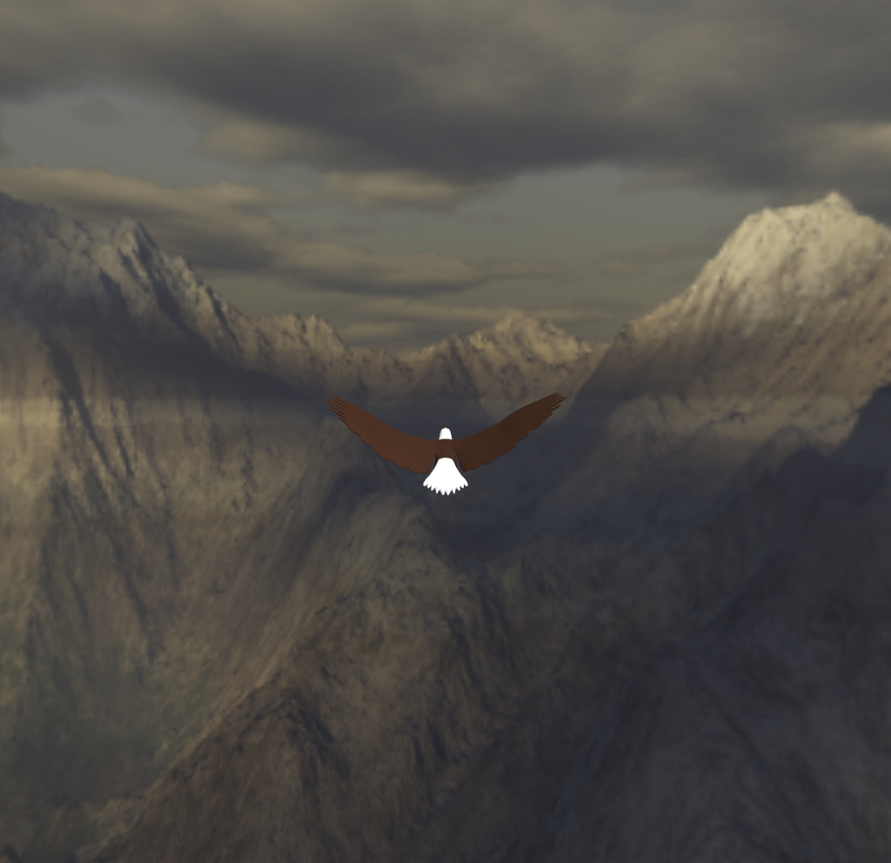
17
＊
BONUS
Sky Box

Slide 18
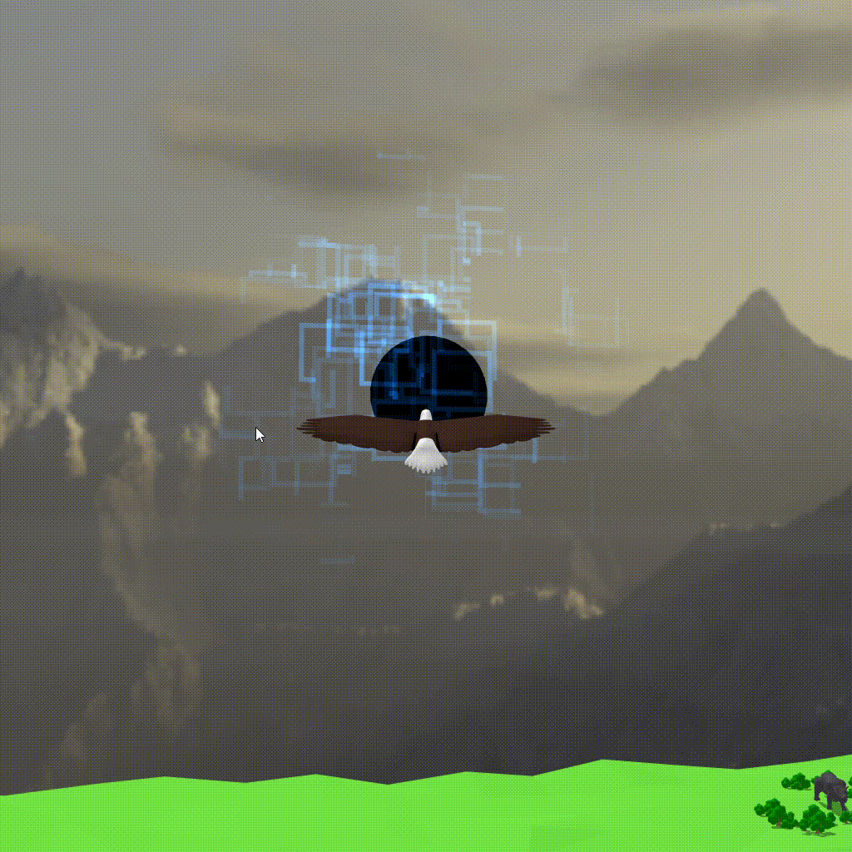
18
＊
BONUS
Particle System

Slide 19
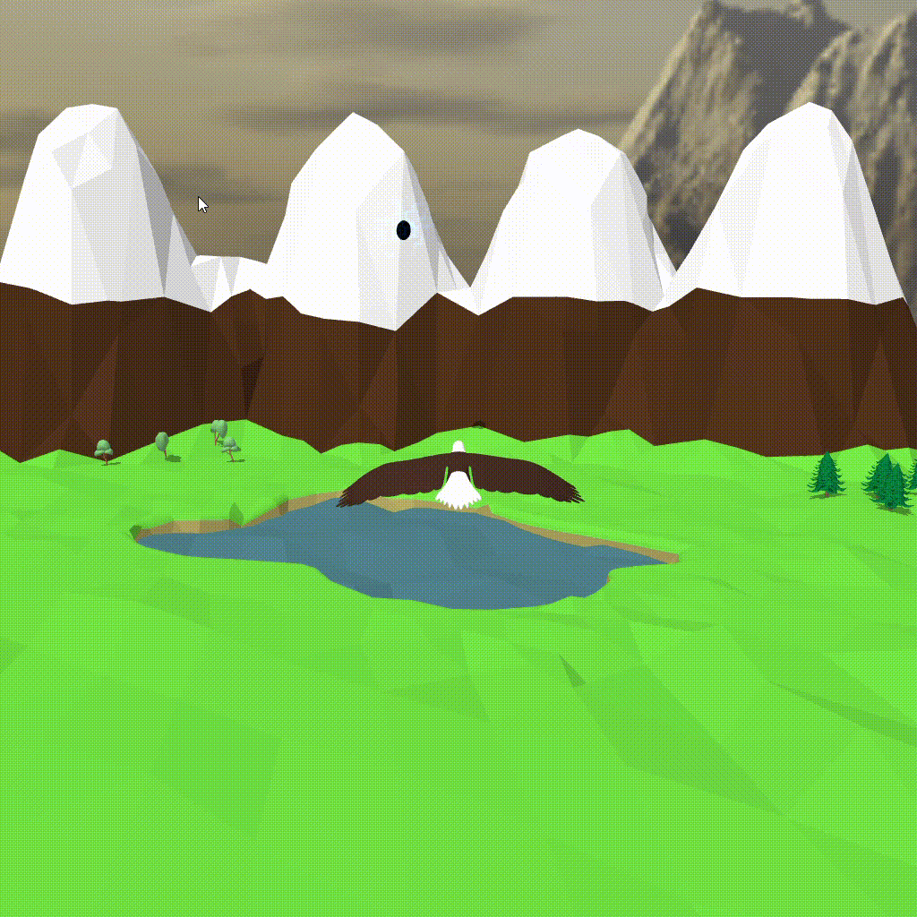
19
＊
BONUS
Skeletal Animation

Slide 20
TODO
Learn more

Slide 21
21
＊
TODO
FLUID SIMULATION
Collision Detection
FUTURE SCENE

Slide 22


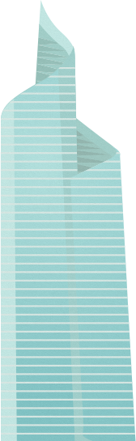

THANK YOU

